Slide 1



Decode Sustainability
IO 4: Dissemination activity
www.decode-council.org
The European Commission support for the production of this publication does not constitute an endorsement of the contents which reflect the views only of the authors, and the Commission cannot be held responsible for any use which may be made of the information contained therein.

Slide 2
I04 Main Objectives
A framework for generic Impact Pathways that University Departments can use to advance their contributions to sustainability
A framework for the creation of Department-specific Impact Roadmaps (based on one of the generic Pathways) to outline the specific steps to be taken by departments to promote positive change

Slide 3
The Pathways have been formulated following the impact tree (Study/Education, Research, Campus Operations) and adding two separate paths focusing on the (department) Governance and the Societal Engagement, respectively.
Each pathway is composed of five steps adapting the five policy levers (see IO1) as follows:
Strategy and awareness: using symbolic and encouragement signals to influence perceptions or values;
Monitoring and organizational learning: to increase the understanding of an issue or reduce uncertainty about how to address it;
Capacity building: to provide, training, skills, and to enable individuals or groups to make decisions or carry out activities;
Incentives : using tangible payoffs (rewards, bonuses, prizes) to induce compliance or to encourage people to do things that they might not have done otherwise;
Authority, voluntary actions: to implement the selected strategies, policies, or specific actions.

Slide 4
Situational factors (see IO1) are listed below :
Limited culture and attention on Sustainability and Sustainable Development issues
Paucity of fundings allocated for teaching and research activities oriented to Sustainability and Sustainable Development topics.
Limited motivation of HEIs academic staff to re-orient their teaching and research activities towards Sustainability and Sustainable Development issues.
Need for innovative teaching models for reskilling and upskilling professional curricula functional to build sustainability-oriented models.
Weak/scarce integrated research, training, and practices suitable to embed SD and Sustain-ability-related issues in HEIs and schools.
Need for evaluation tools of sustainability and education for sustainable development (ESD) competencies (operationalization of sustainability competencies).

Slide 5

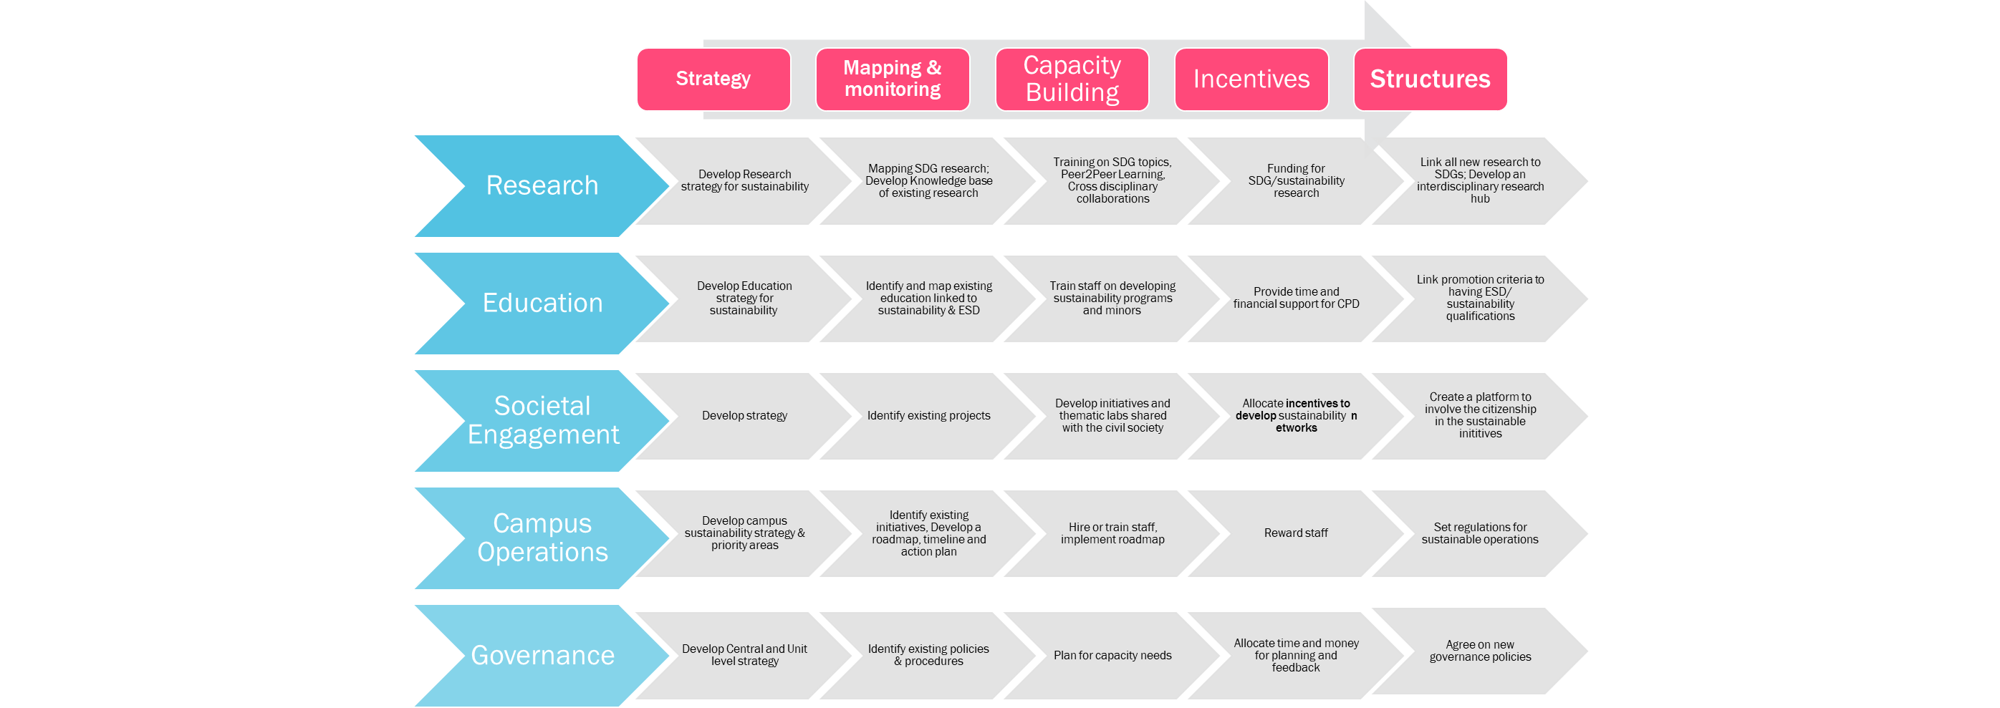
Pathways:
Process (path) to develop Research, Education, Societal engagement, campus operations and Governance in order to support territorial strategies for environmental sustainability and sustainable development.
Toolkit

Slide 6
Strategy
Mapping & monitoring
Capacity Building
Incentives
Structures
Research
Develop Research strategy for sustainability
Mapping SDG research; Develop Knowledge base of existing research
Education
Develop Education strategy for sustainability
Identify and map existing education linked to sustainability & ESD
Societal Engagement
Develop strategy
Identify existing projects
Campus Operations
Governance
Training on SDG topics, Peer2Peer Learning, Cross disciplinary collaborations
Funding for SDG/sustainability research
Link all new research to SDGs; Develop an interdisciplinary research hub
Train staff on developing sustainability programs and minors
Link promotion criteria to having ESD/ sustainability qualifications
Provide time and financial support for CPD
Develop initiatives and thematic labs shared with the civil society
Allocate incentives to develop sustainability networks
Develop campus sustainability strategy & priority areas
Identify existing initiatives, Develop a roadmap, timeline and action plan
Hire or train staff, implement roadmap
Reward staff
Set regulations for sustainable operations
Develop Central and Unit level strategy
Identify existing policies & procedures
Plan for capacity needs
Allocate time and money for planning and feedback
Agree on new governance policies
Create a platform to involve the citizenship in the sustainable inititives

Slide 7
Dissemination Activity
In presence
Virtual

Slide 8
IO4: Dissemination Activities
Institutional Website: opening of a section on UNINA website of “Decode Sustainability” project and sharing it on all the pages of the various unina departments.

Slide 9
IO4: Dissemination Activities
Seminars already held:
  Performed n. 5 seminars related to the "Decode Sustainability" project, in the "EVOLUTION OF FINANCIAL MARKETS" course from March 2022 to May 2022, for a total of 10h.
  Performed n. 5 seminars related to the "Decode Sustainability" Project, in the course "INTERNATIONAL RELATIONS AND SCENARIO ANALYSIS" from March 2023 to May 2023, for a total of 10h.
  Performed n. 1 presentation seminar of the "Decode Sustainability" Project, on 03/17/2023, within the PhD in "Public Policies of Cohesion and Convergence in the European Scenario. For a total of 2h.
  Performed n. 15 presentation seminars, and progress of the project activities with analysis of the various reports, at the Interdepartmental Research Center Urban Planning and Territorial Planning Laboratory "Raffaele d'Ambrosio" - LUPT.

Slide 10
IO4: Dissemination Activities
Seminars to be held:
Further seminars have been planned for the presentation of the project results and setting of Department-specific Impact Roadmaps hypotheses, with respect to the chosen pathways.

Slide 11
IO4: Dissemination Activities
Platforms social: Instagram, Facebook, Spotify, Youtube, ecc..

Slide 12
IO4: Dissemination Activities
Tutorial: recorded lessons/seminars in order to send them on multiple channels and/or upload them to a section of the platform with access allowed after registration.
Totem: self-supporting pillars, usually of plastic material, capable of conveying a message and/or a path to acquire the required information.
Final conference: presentation, in presence and remotely, of "Guidelines for the creation of Department-specific Impact Roadmaps". Conference in the organization phase and scheduled for the month of July 2023.

Slide 13
Guidelines for the creation of Department-specific Impact Roadmaps (based on one of the generic Pathways)
The need to seek a "dynamic balance between material living conditions and quality of life" (OECD - 2011) is emerging in an increasingly strong way in society. This transition to Sustainability requires:
  overcoming of the current globalization with variable geometry;
  abandonment of geopolitical competitions;
  strengthening of multilateralism;
  a knowledge system (HEI) capable of offering innovative solutions that can be transferred to territorial systems (third mission).
The resulting system can constitute the winning strategy for pursuing the goal of Sustainable Development, as defined by the United Nations in 2015.

Slide 14
Compared to the point:
  a knowledge system (HEI) capable of offering innovative solutions that can be transferred to territorial systems (third mission).
Each HEI Institution will have to implement an integrated strategy for Sustainability and Sustainable Development:
Level I:
  establishment of a Steering Group
  Fundraising for sustainability
Level II:
  Monitoring of state of institutionalization through the measurement of three indicators (teaching, research, technology transfer)
  Advocacy for sustainability
Level III:
  Plan for the development of research on sustainability issues (Environmental and climate goals, Goals 13 of the 2030 Agenda) and sustainable development (other goals of the 2030 Agenda)
  Higher education plan for students (new skills and new professional skills)
  Plan to respond to the territorial request for sustainable development.
Levello IV:
  Incentives for staff and students.
WORKING PROGRESS!!!!

Slide 15


Thank you
Project partners:
www.decode-council.org
Project Number: 2020-1-IT02-KA203-079952
The European Commission support for the production of this publication does not constitute an endorsement of the contents which reflect the views only of the authors, and the Commission cannot be held responsible for any use which may be made of the information contained therein.

